Slide 1

Travel Trends:
Impact of Influenza, Pneumonia, and COVID-19.
Carolina Data Challenge 2024
Asa Huang, Terry Zheng, Andy Huoy, Joey Xue

Slide 2
Table of contents
1
2
3
4
5
6
Introduction
Dataset
Procedures
Findings
Analysis
Future of this Project

Slide 3
HOW does Influenza, Pneumonia, and COVID-19 affect travel plans in the United States?

Slide 4
In what age group do most deaths occur?
How did the number of deaths from COVID-19, pneumonia, and influenza change over time?
Are there many recorded deaths in the recent years?
Which disease has caused the most amount of deaths?
Where do most deaths occur?

Slide 5

Introduction
What are we studying?
Infectious diseases such as: Influenza, Pneumonia, and COVID-19 have significantly impacted our daily life
It has affected travel patterns and disrupted the way people move within and between regions.
The correlation between disease outbreaks and travel trends is studied to mitigate the impact of future outbreaks.
What are we looking at?
We analyzed data from the "Provisional Death Counts for Influenza, Pneumonia, and COVID-19"
Provides death counts reported by state, age group, and disease type
We aim to explore the relationship between these outbreaks and changes in travel behavior across the United States.

Slide 6
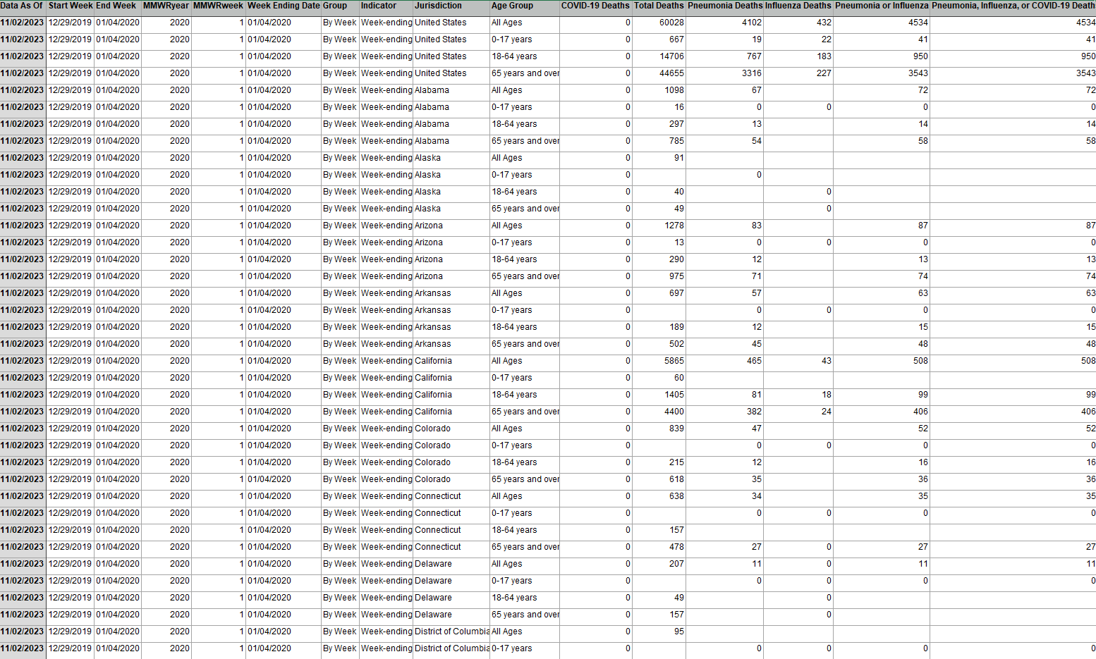
Dataset
Provided Information
Data As Of
Start Week
End Week
MMWRyear
MMWRweek
Week Ending Date
Group
Indicator
Jurisdiction
Age Group
COVID-19 Deaths
Total Deaths
Pneumonia Deaths
Influenza Deaths
Pneumonia or Influenza
Pneumonia, Influenza, or COVID-19 Deaths

Slide 7
Our Procedures
Data Wrangling
Data Organization
Data Visualization

Slide 8
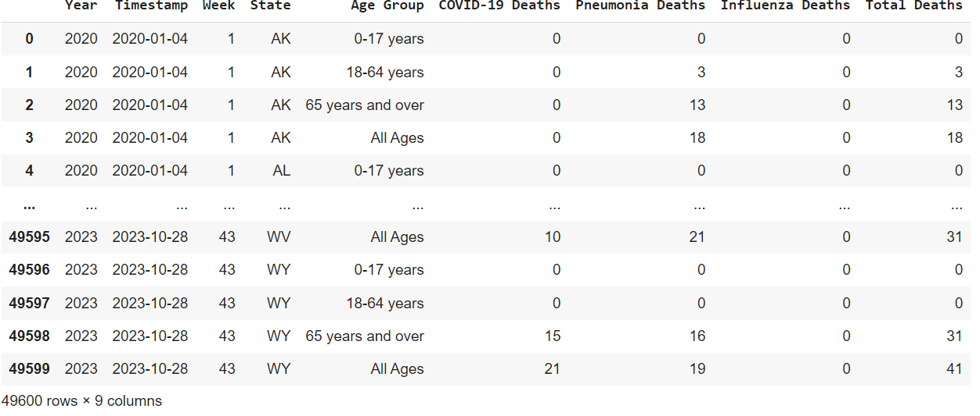
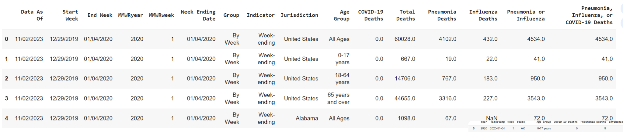
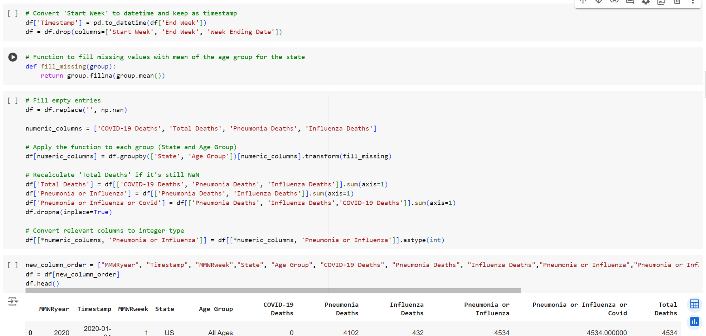
Data Wrangling

Slide 9
Steps
Remove the columns 'Data As Of', 'Indicator', 'Group', 'Pneumonia or Influenza', 'Pneumonia, Influenza, or COVID-19 Deaths' as they are unnecessary or do not make sense
Fill in missing values in the dataset with what makes sense the most in each column
Rename columns “MMWRyear” to “Year”, “MMWRweek” to “Week”, and “Jurisdiction” to “State” so that they are more comprehensible
Abbreviate each of the states (why not}.

Slide 10
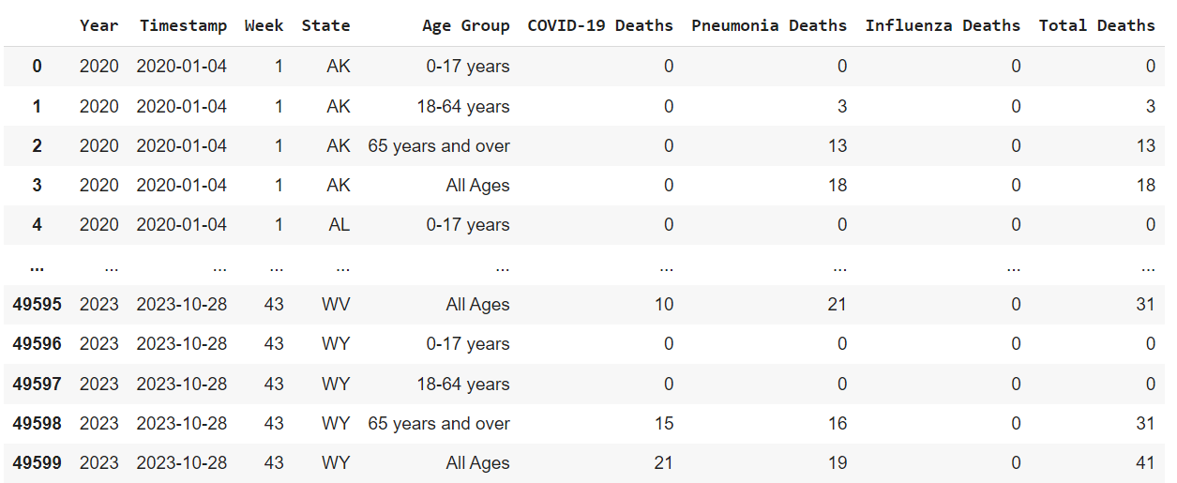
Uncleaned Dataset
Cleaned Data Set

Slide 11
Data Organization

Slide 12
Steps
Reorganize the order of the columns so that the information is easier to process when analying
Initiate different sorting methods in order to prepare our data for the next step, visualization
Export data if needed

Slide 13
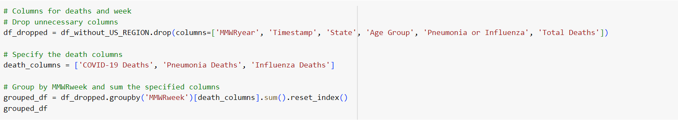
Grouping the Dataset

Slide 14
Data Visualization
Visualizing our organized data by using source such as:
Tableau
Plotly

Slide 15
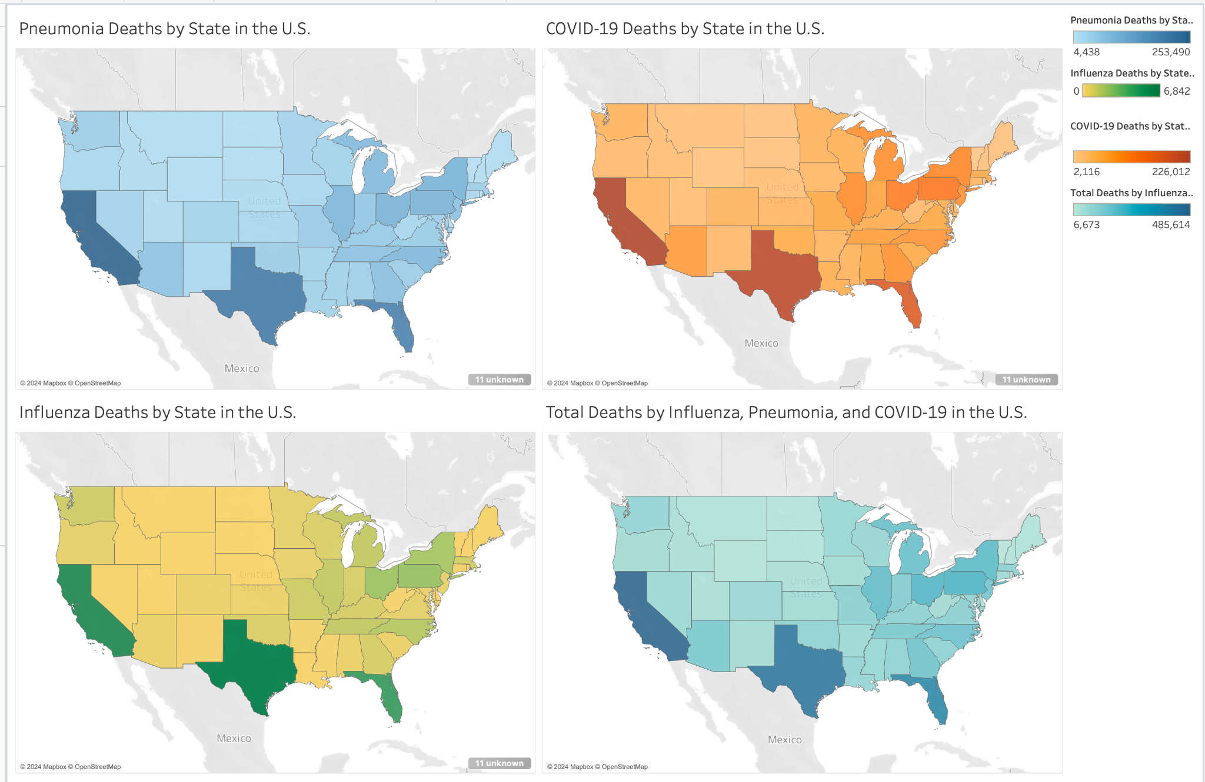

Slide 16
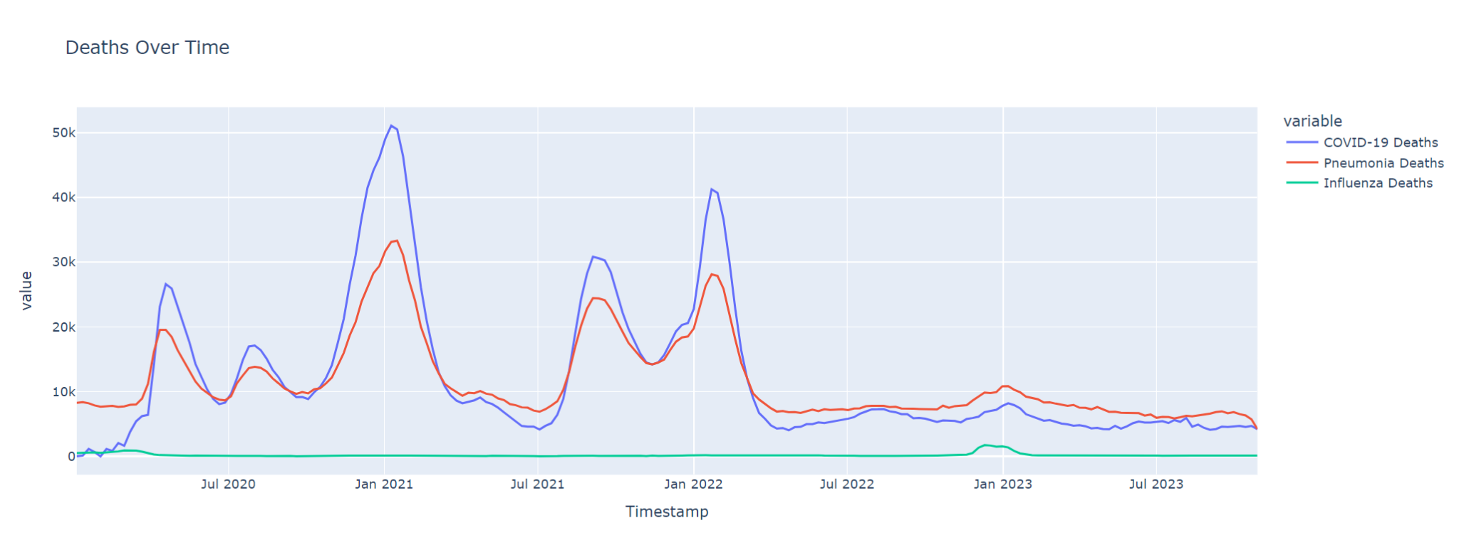

Slide 17
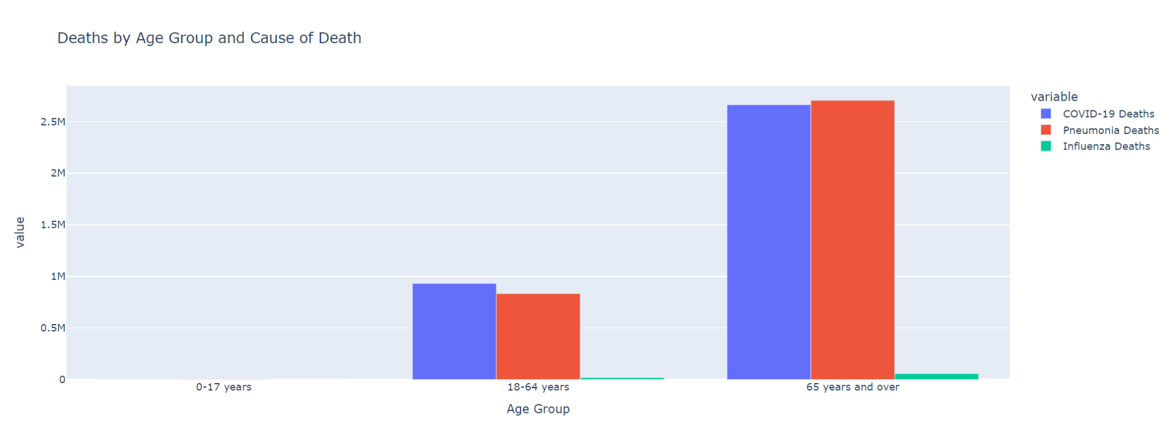

Slide 18
Our Key Findings
Deaths for Influenza, Pneumonia, and Covid-19 have fallen from January 2022 up until the most recent date on the dataset, November 2023
States with a larger population or tourist attraction such as Texas and California have a higher death count compared to other states
Covid-19 and Pneumonia deaths spiked a couple of times including January 2021 and February 2022
Children up to the age of 17 are unlikely to pass away due to the diseased compared to adults
People over the age of 65 are more liked to pass away due to the diseased compared to people ages below them
Covid-19 and Pneumonia caused many more deaths than Influenza

Slide 19
How does Influenza, Pneumonia, and COVID-19 affect travel plans in the United States?
High-Risk Populations
Older people are more likely to cancel or delay trips to avoid getting sick, especially when it comes to crowded places.
Travel to High-Risk States
States with big populations and tourist spots have more deaths, so people might avoid traveling there during high infection times.
Timing and Travel Seasons
Deaths from these diseases increase in the winter, so people may avoid traveling or push back their plans during these months.
Decline In Deaths
Due to the decline of death from these diseases since early 2022 people may see this as a opportunity to travel while it is safer for them to

Slide 20
Future of this Project
The project will continue to focus on understanding how diseases like Influenza, Pneumonia, and COVID-19 impact travel plans. We aim to gather more data, track trends, and identify how travelers adjust their plans during outbreaks. The goal is to provide insights that help people make safer travel decisions and adapt to changing health conditions. As the project grows, it will continue to monitor new patterns and improve recommendations for future travel planning.

Slide 21
WE APPRECIATE YOUR TIME!

